Slide 1
Analytical bot
Group members:
Thanasoonton Chewakietyingyong M6/20
Kasidit Pitukthum M6/19
Tanapoom Chanthra M6/19

Slide 2
About our project “Analytical Bot”
  Multi-purpose analytical application which coded by using python programming languages due to the following reasons:
    Language structure is easy with dynamic systems
    Widely all over the world with high flexibility and learning curve comparing to other languages
    Considered as the best language for new technologies including Machine learning,
    Big data management, Data analysis and visualization
    Rapid and cross platform prototyping
    Data analysis capabilities
  The project includes two sections: The data analysis (AnalystCX) and the chatbot (Coconutz)

Slide 3
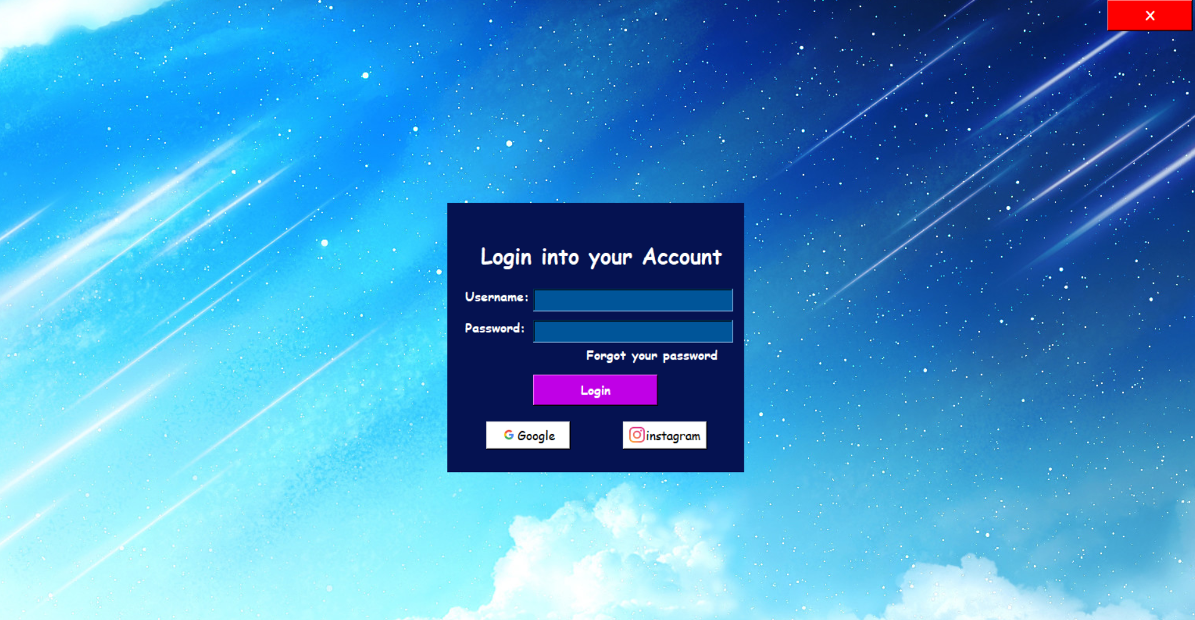

Slide 4
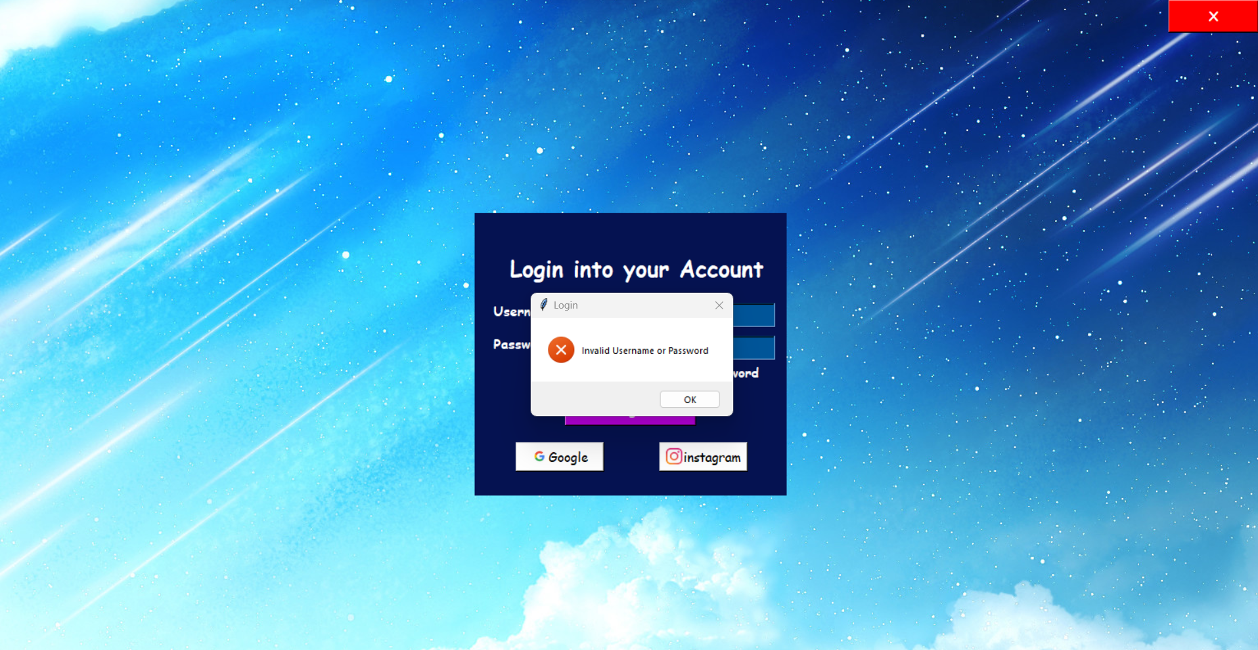

Slide 5


Slide 6
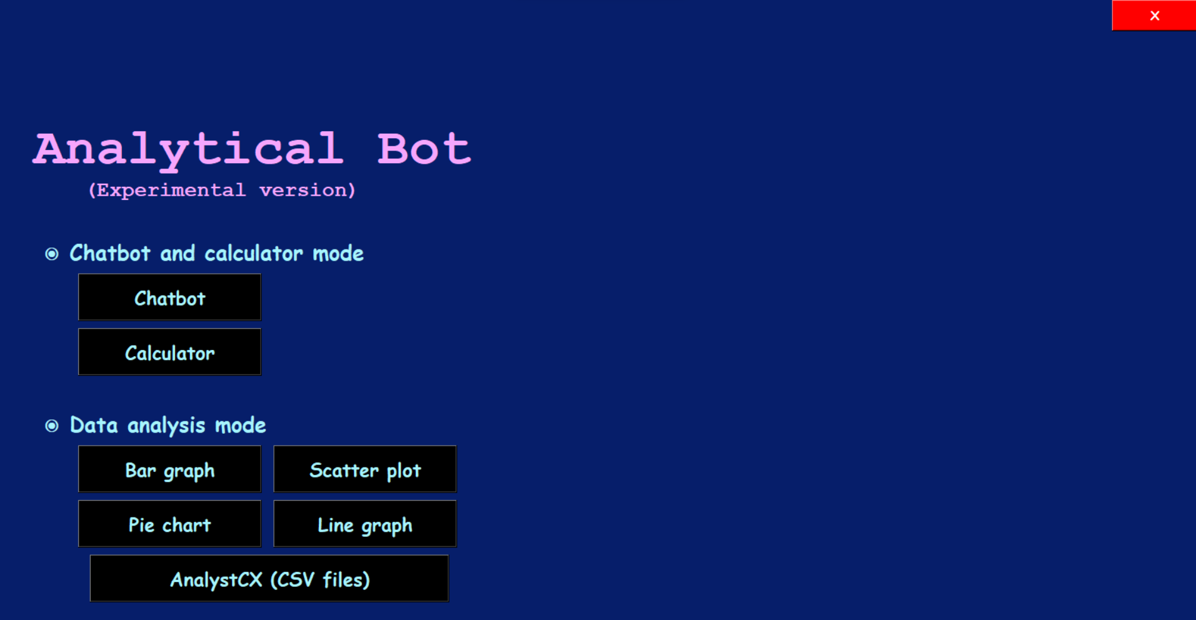

Slide 7
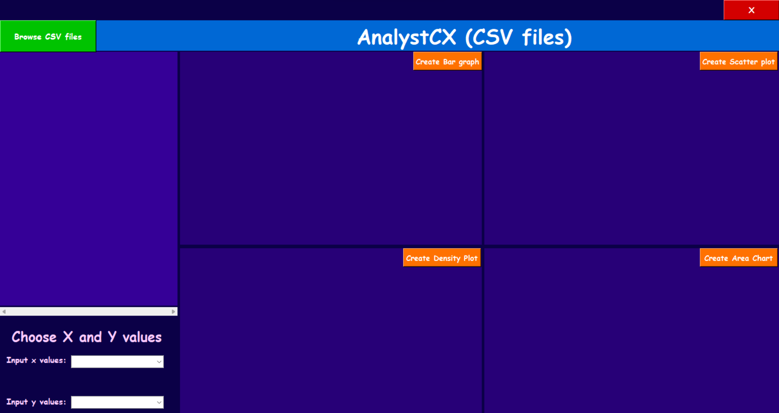

Slide 8
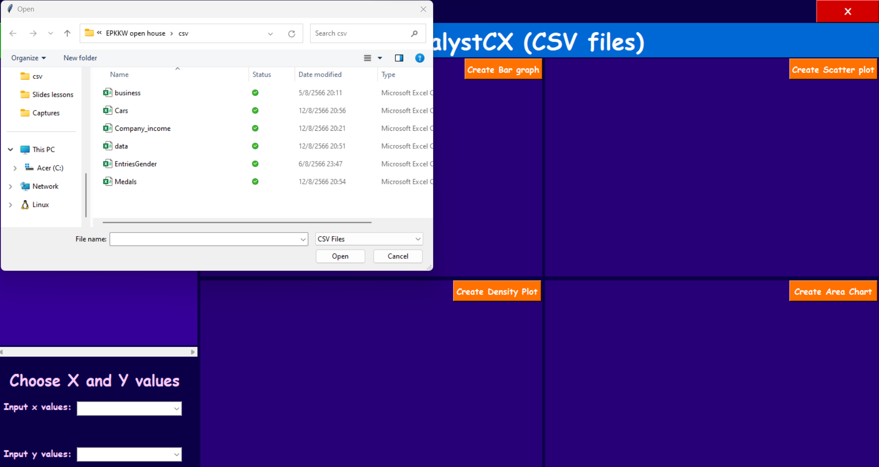

Slide 9
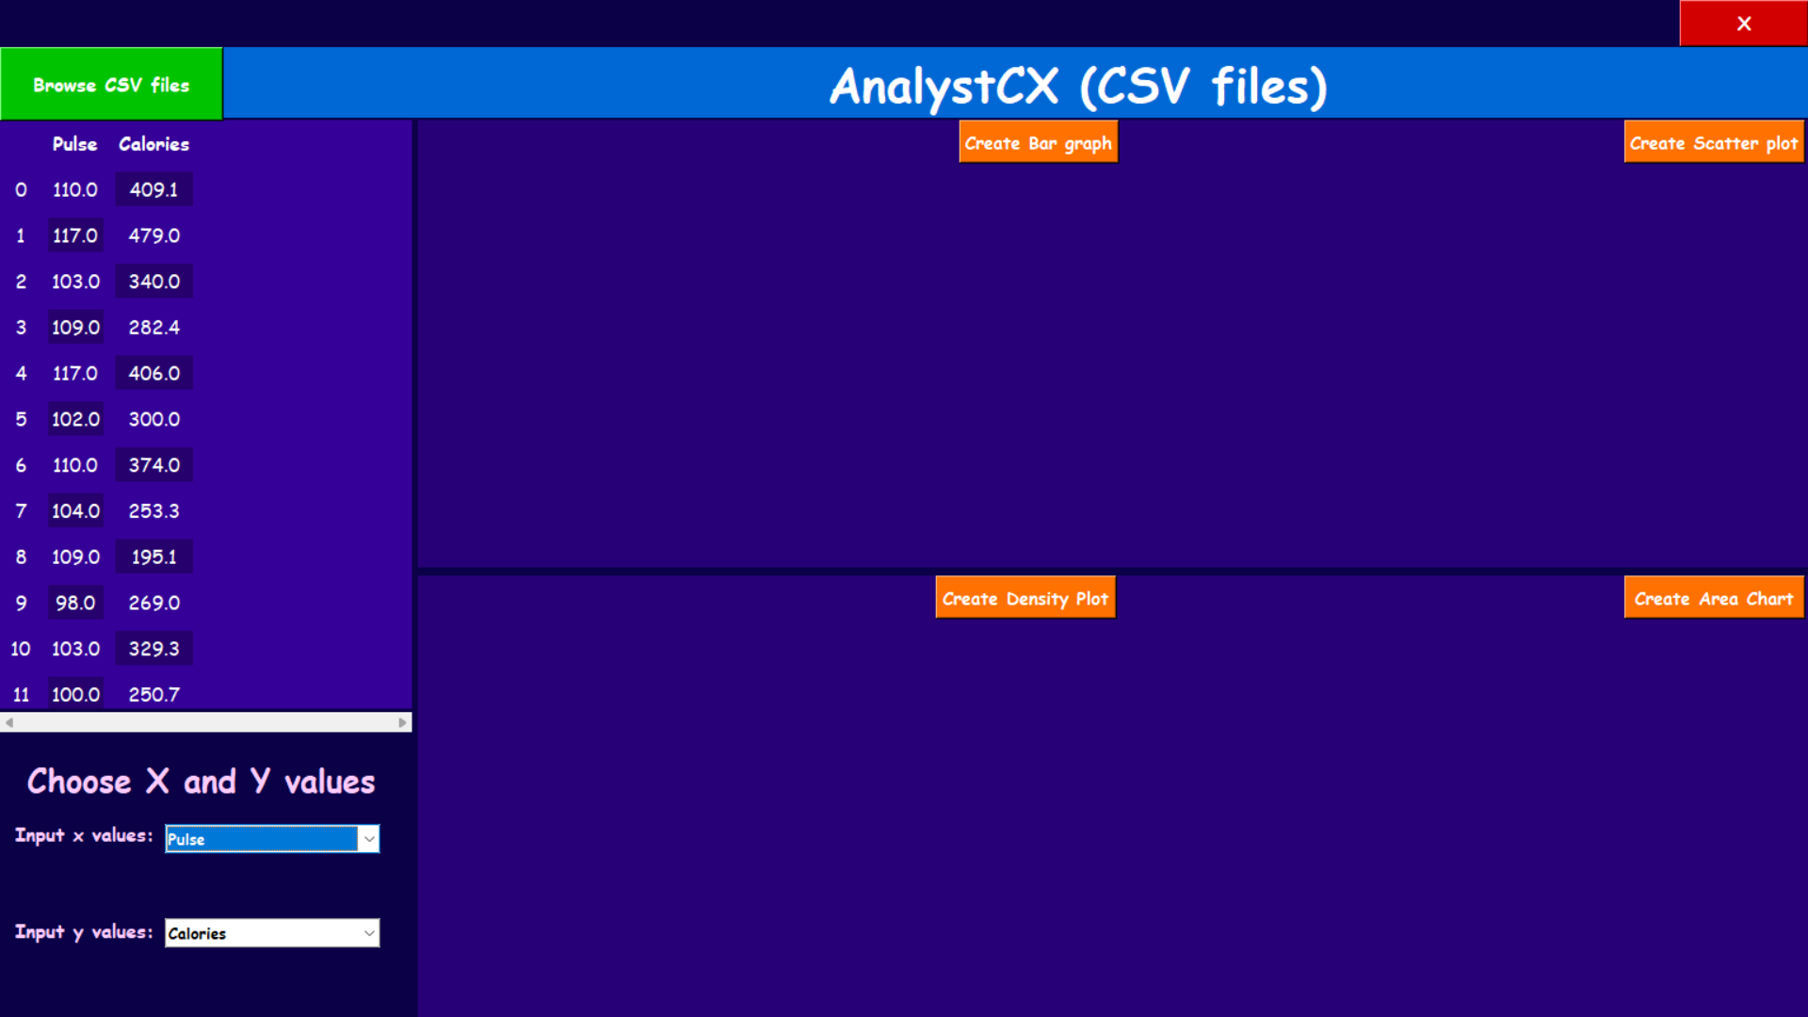

Slide 10
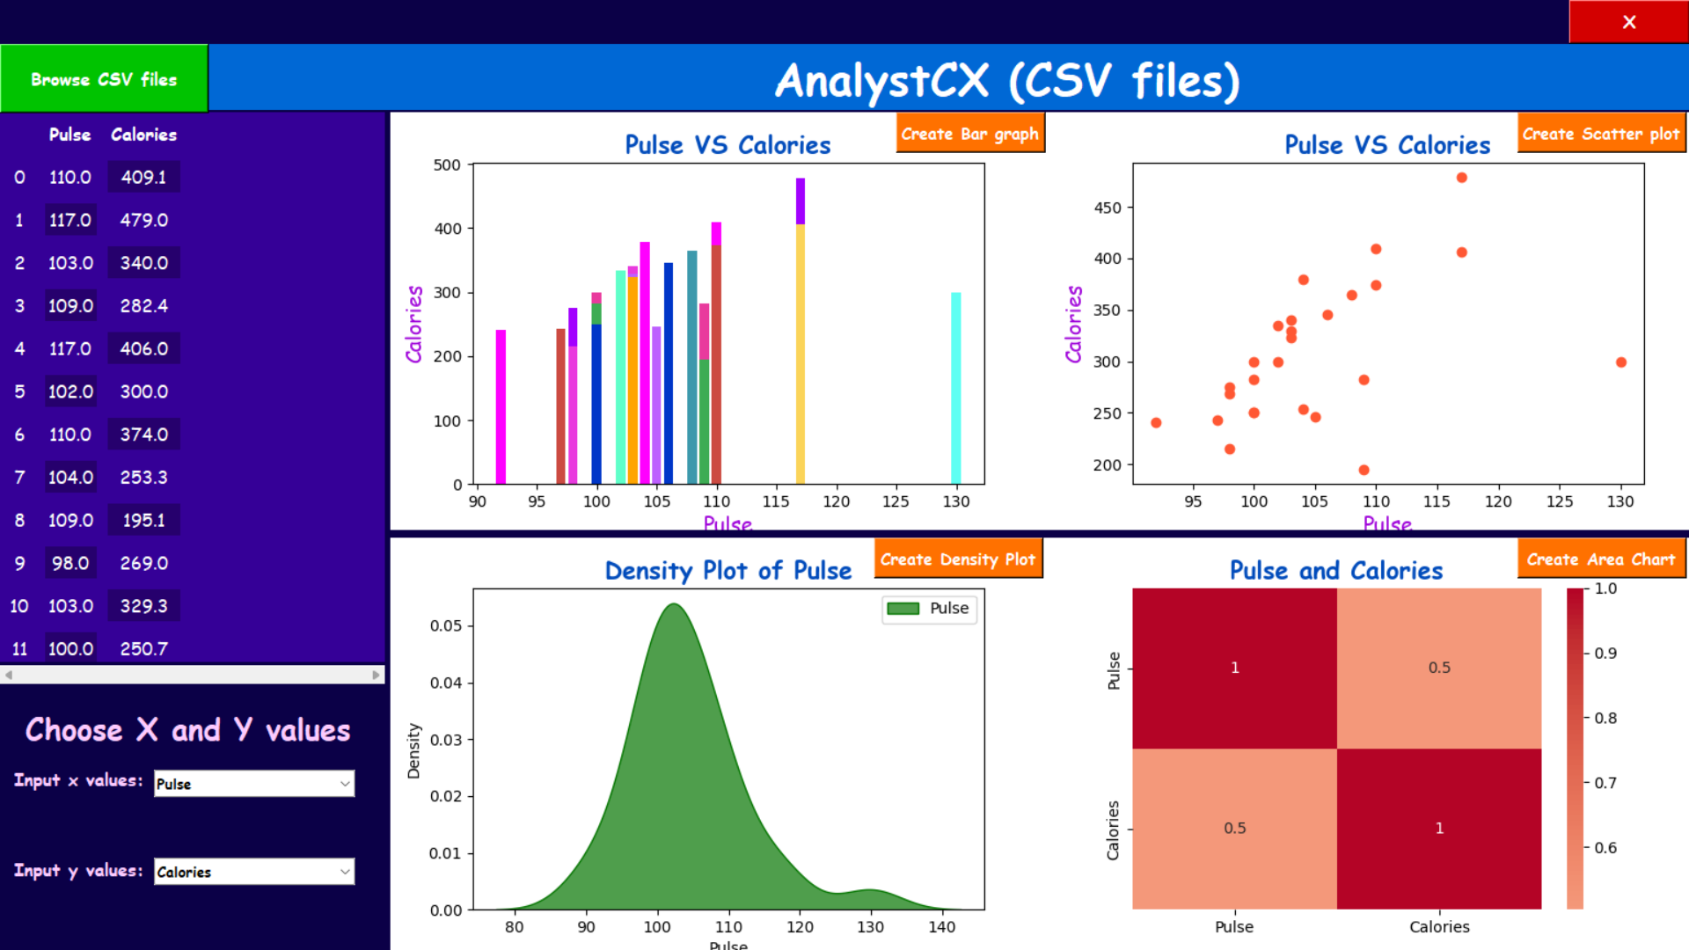

Slide 11
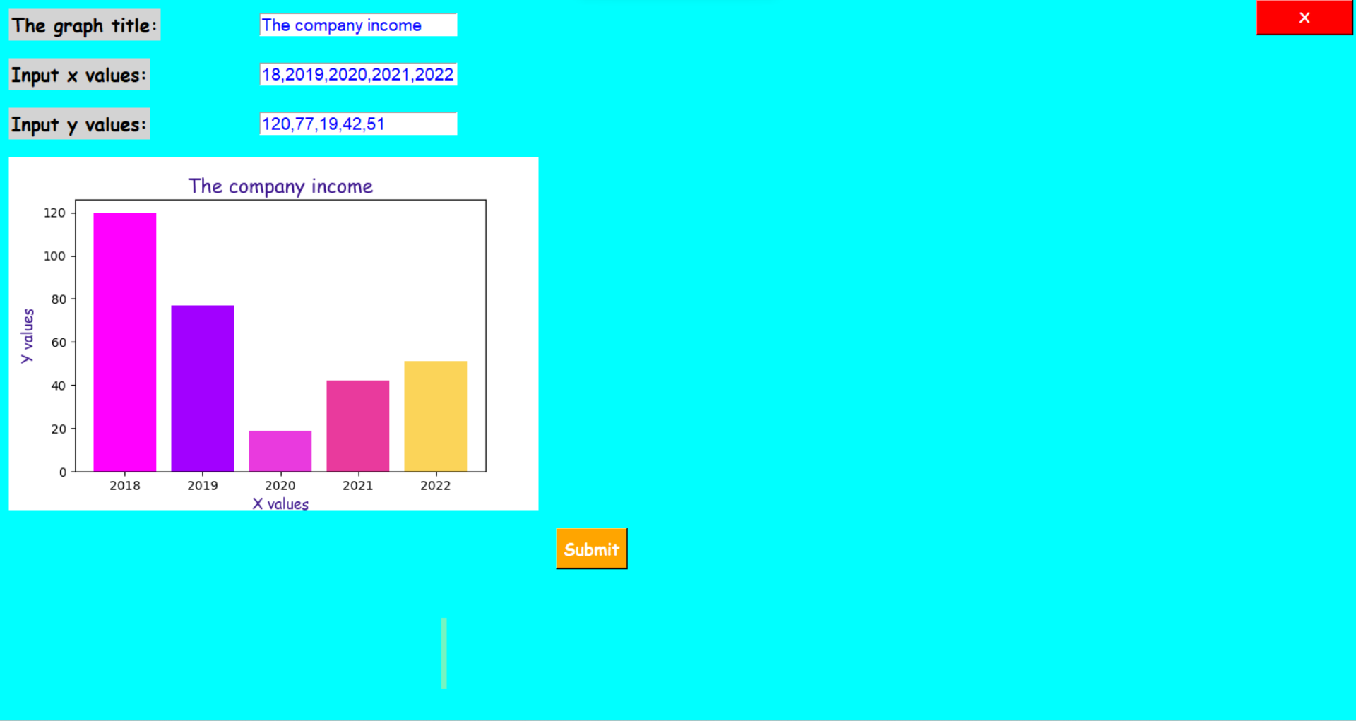

Slide 12
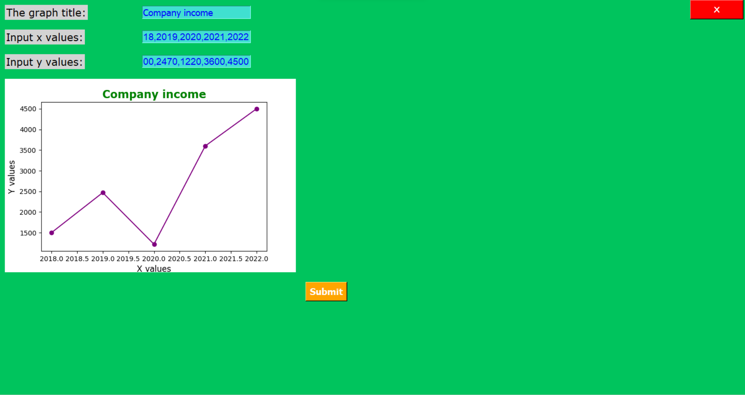

Slide 13
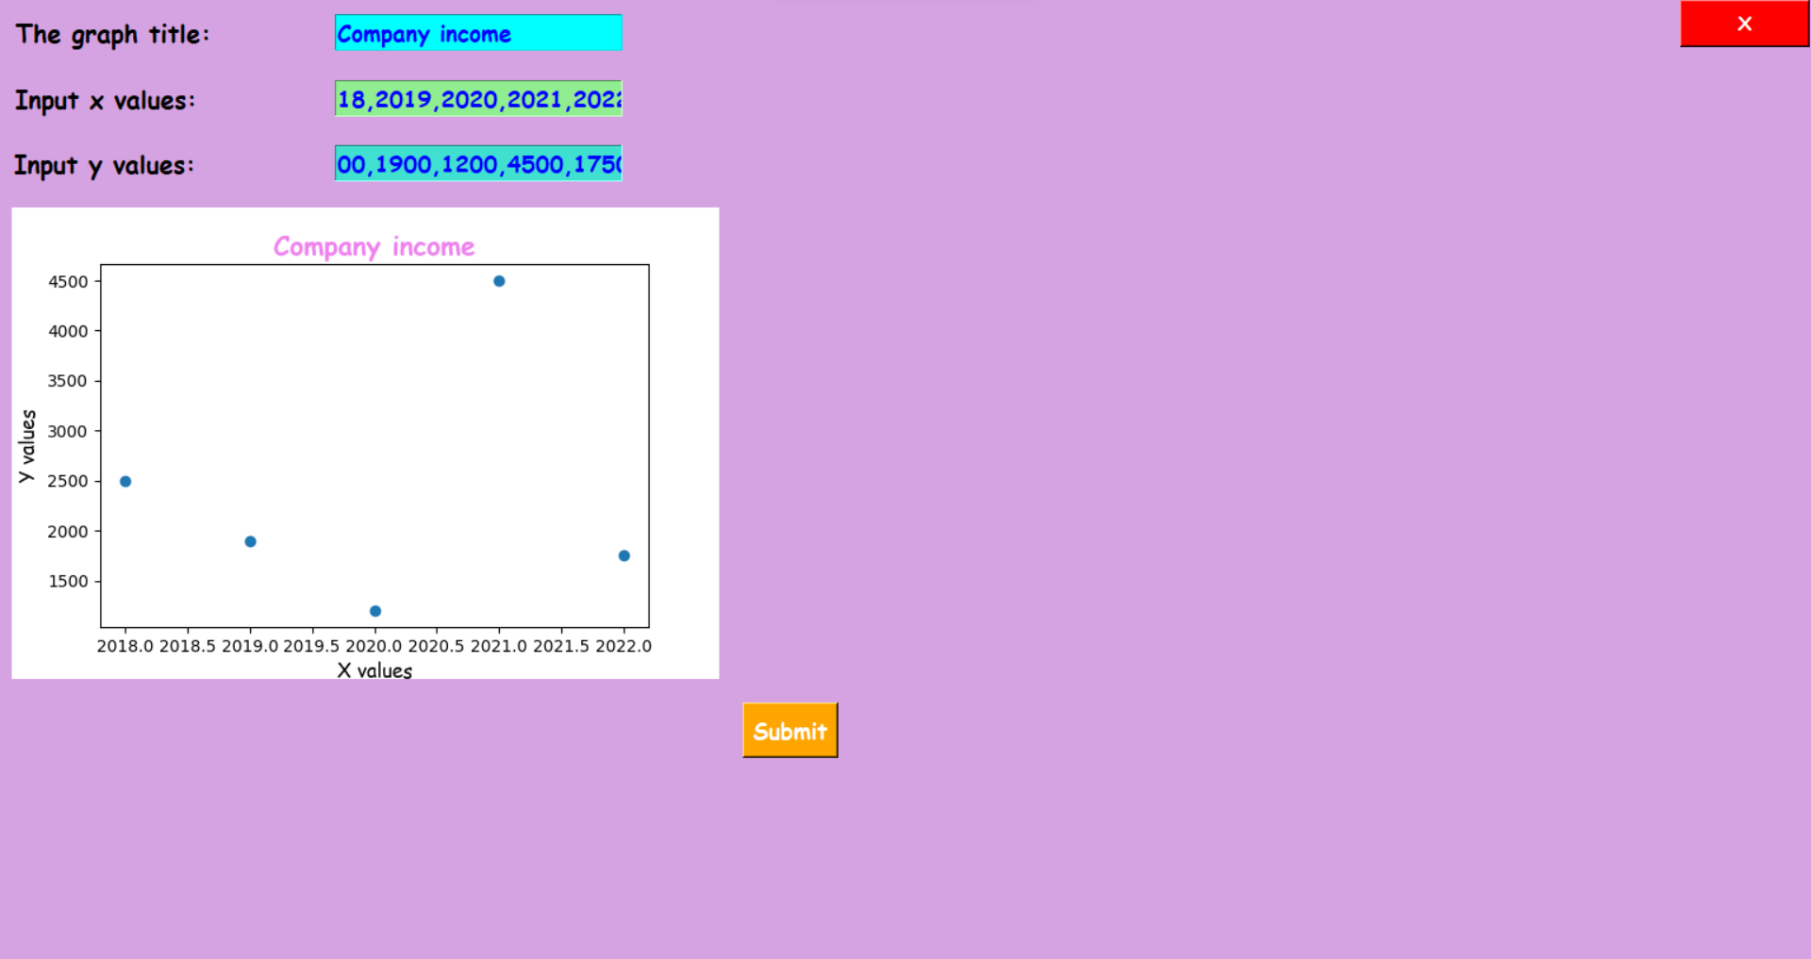

Slide 14
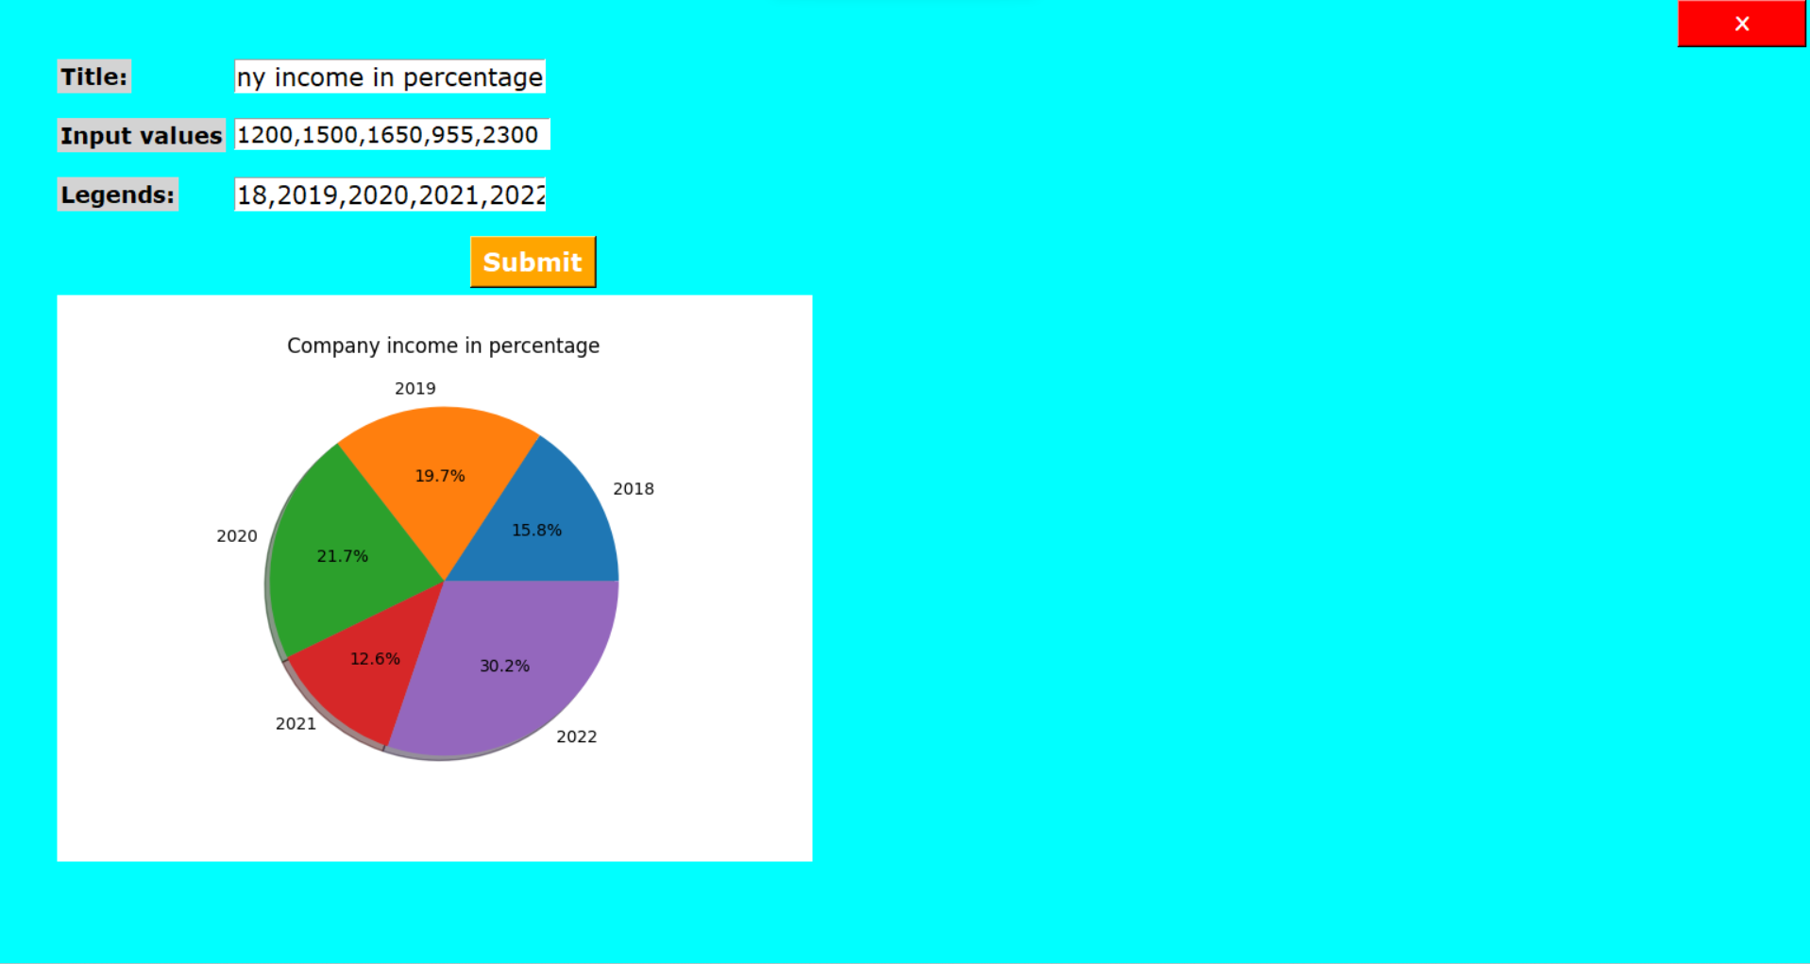

Slide 15
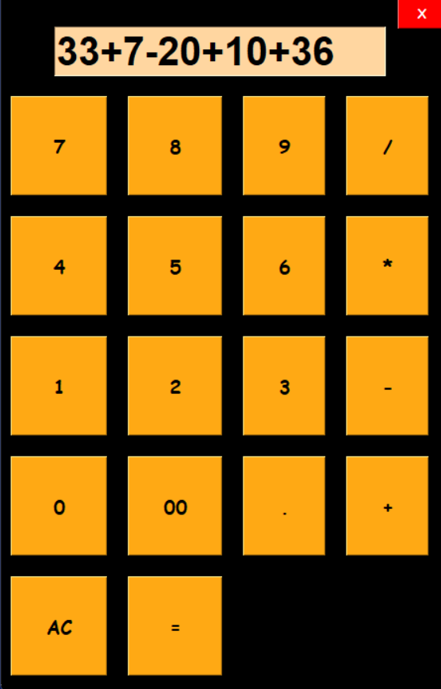
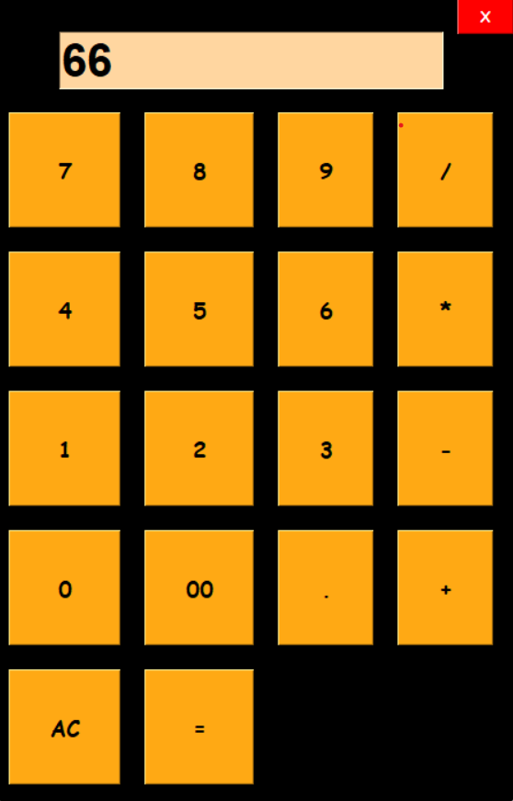

Slide 16
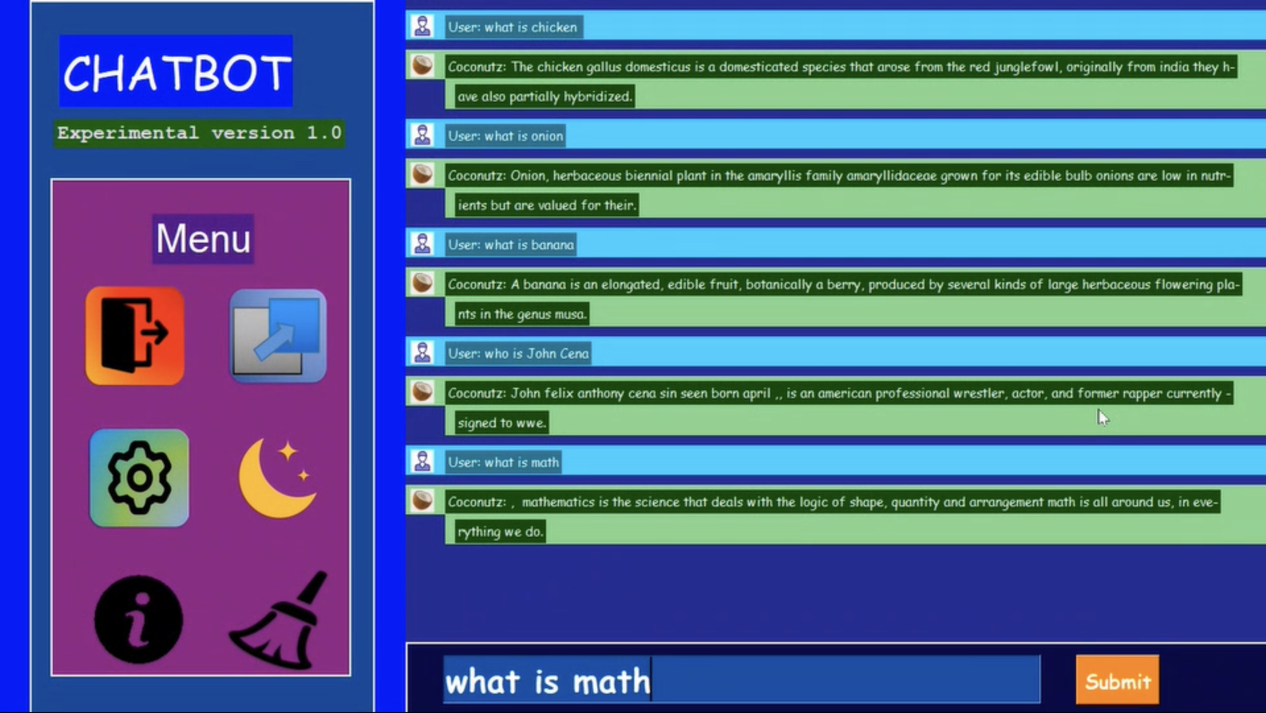

Slide 17
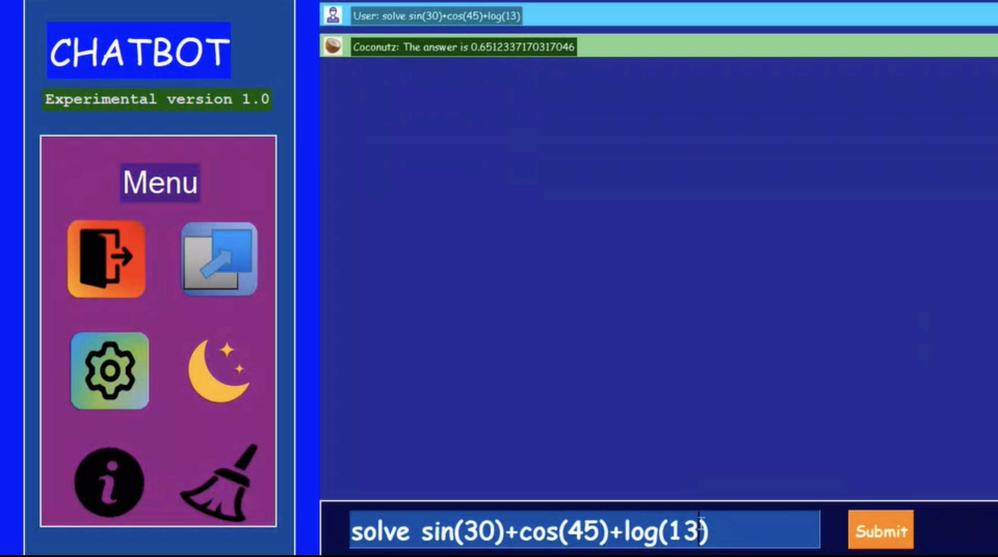

Slide 18


